Slide 1
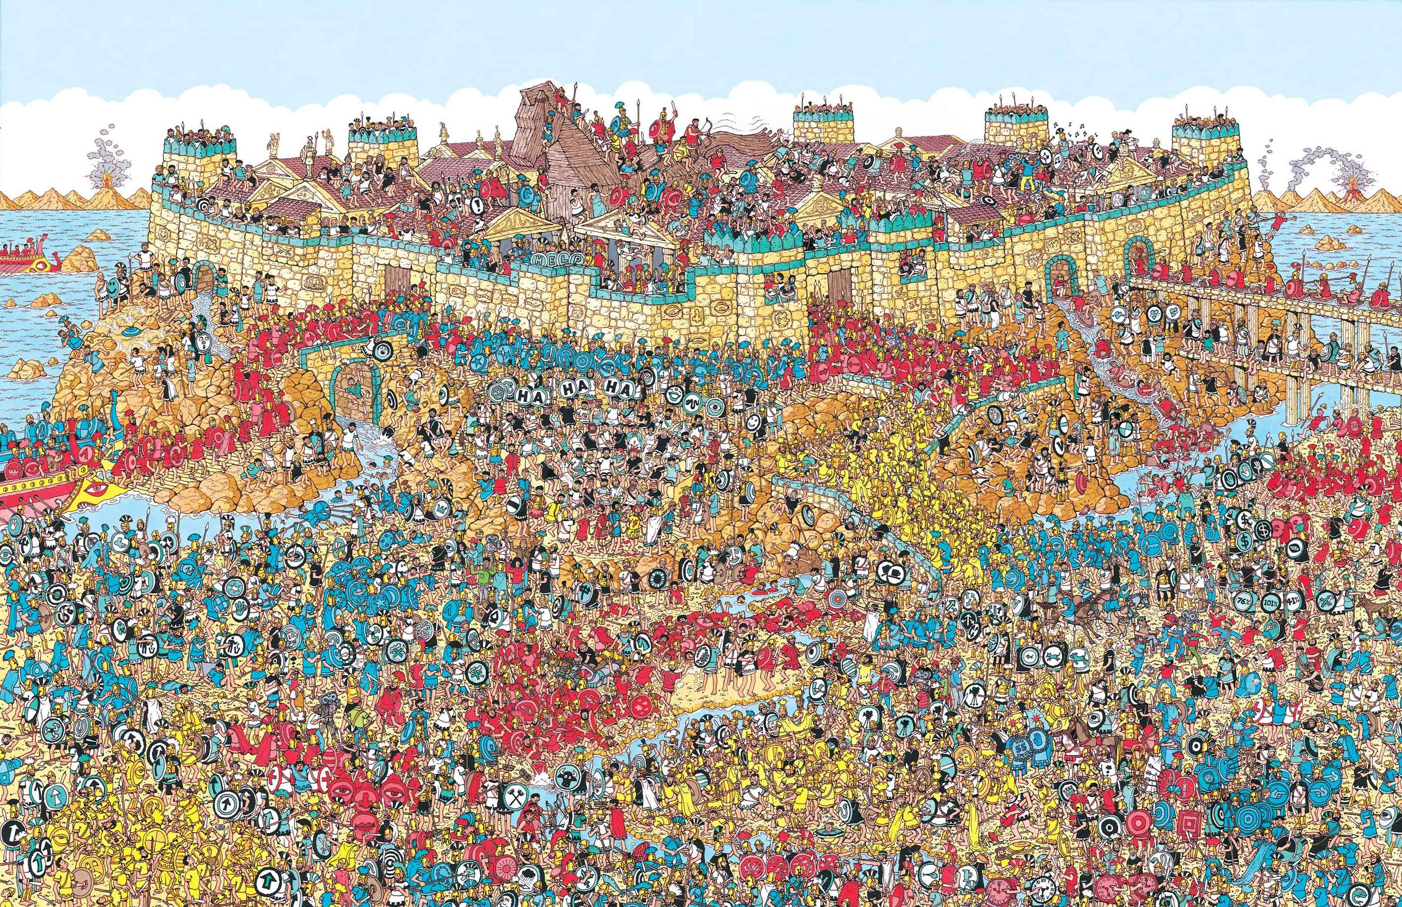
Where’s Waldo
… Solved by a computer

Slide 2
Dataset
our own Dataset
400 Waldos 1000 Non Waldos
Picture size too big (200 x 200 px)
Dataset from the internet
Very few Waldos
Sometimes Waldo is cut in half
Some wrong Waldos
Our own Dataset 2.0
Based on the Dataset from the internet
More good Waldos, less bad Waldos

Slide 3
Model

Slide 4
Results
Waldo search script:
Subdividing picture into small overlaping squares
Feeding tiles one by one into model
Visualize Output by drawing rectangles onto original picture
Threshold of 0.9
Best matches: Red
Mediocre matches: Blue
Rest: black

Slide 5
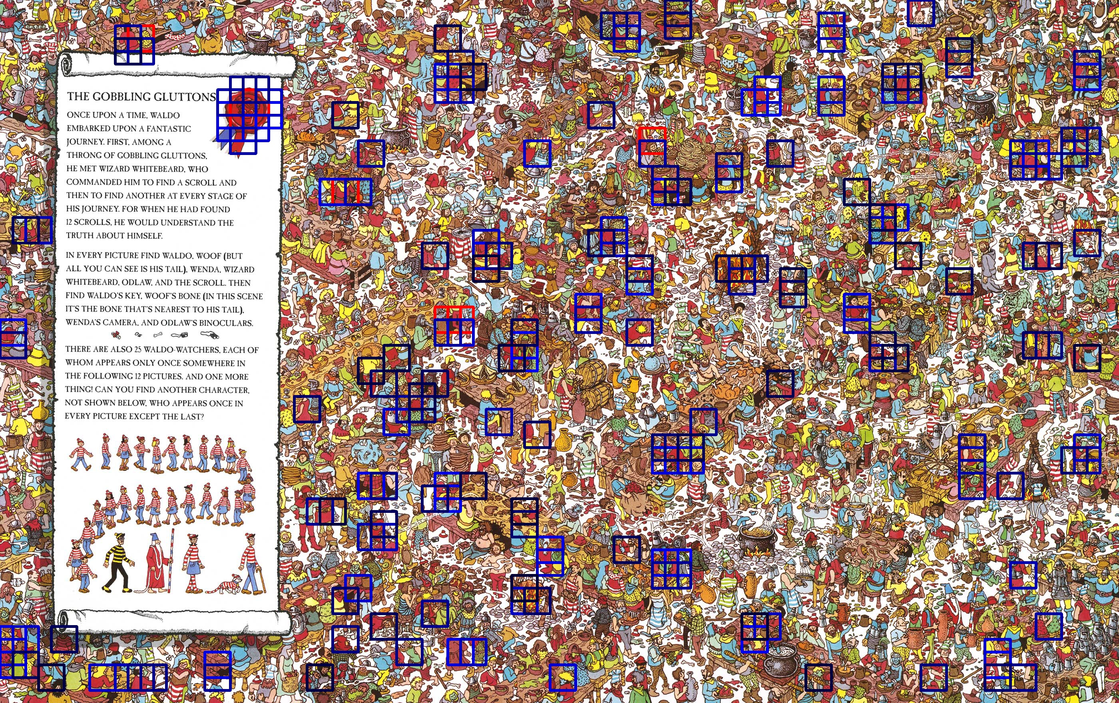
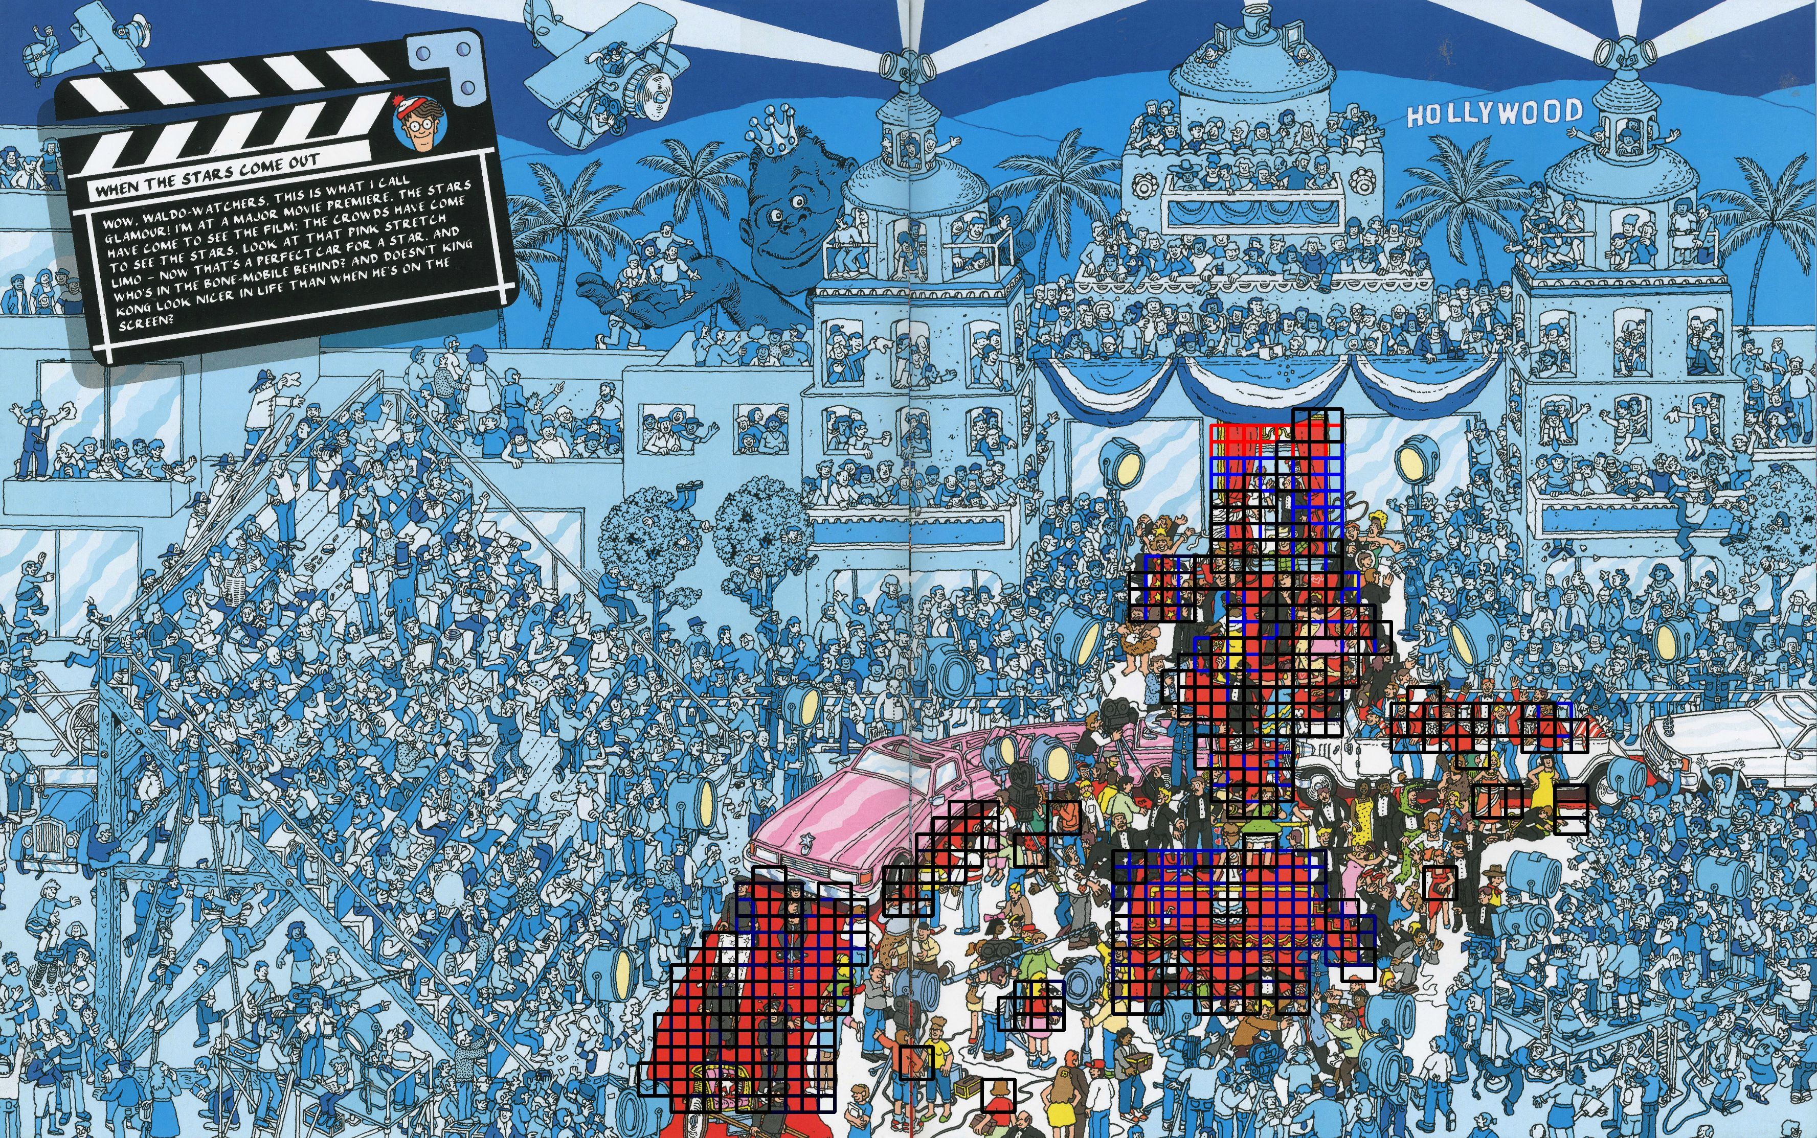
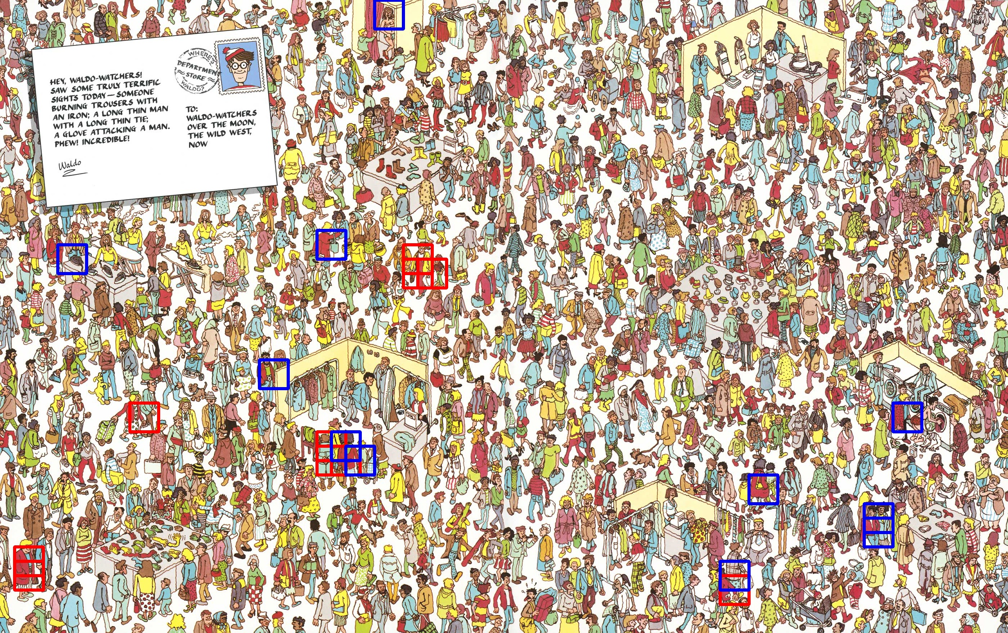
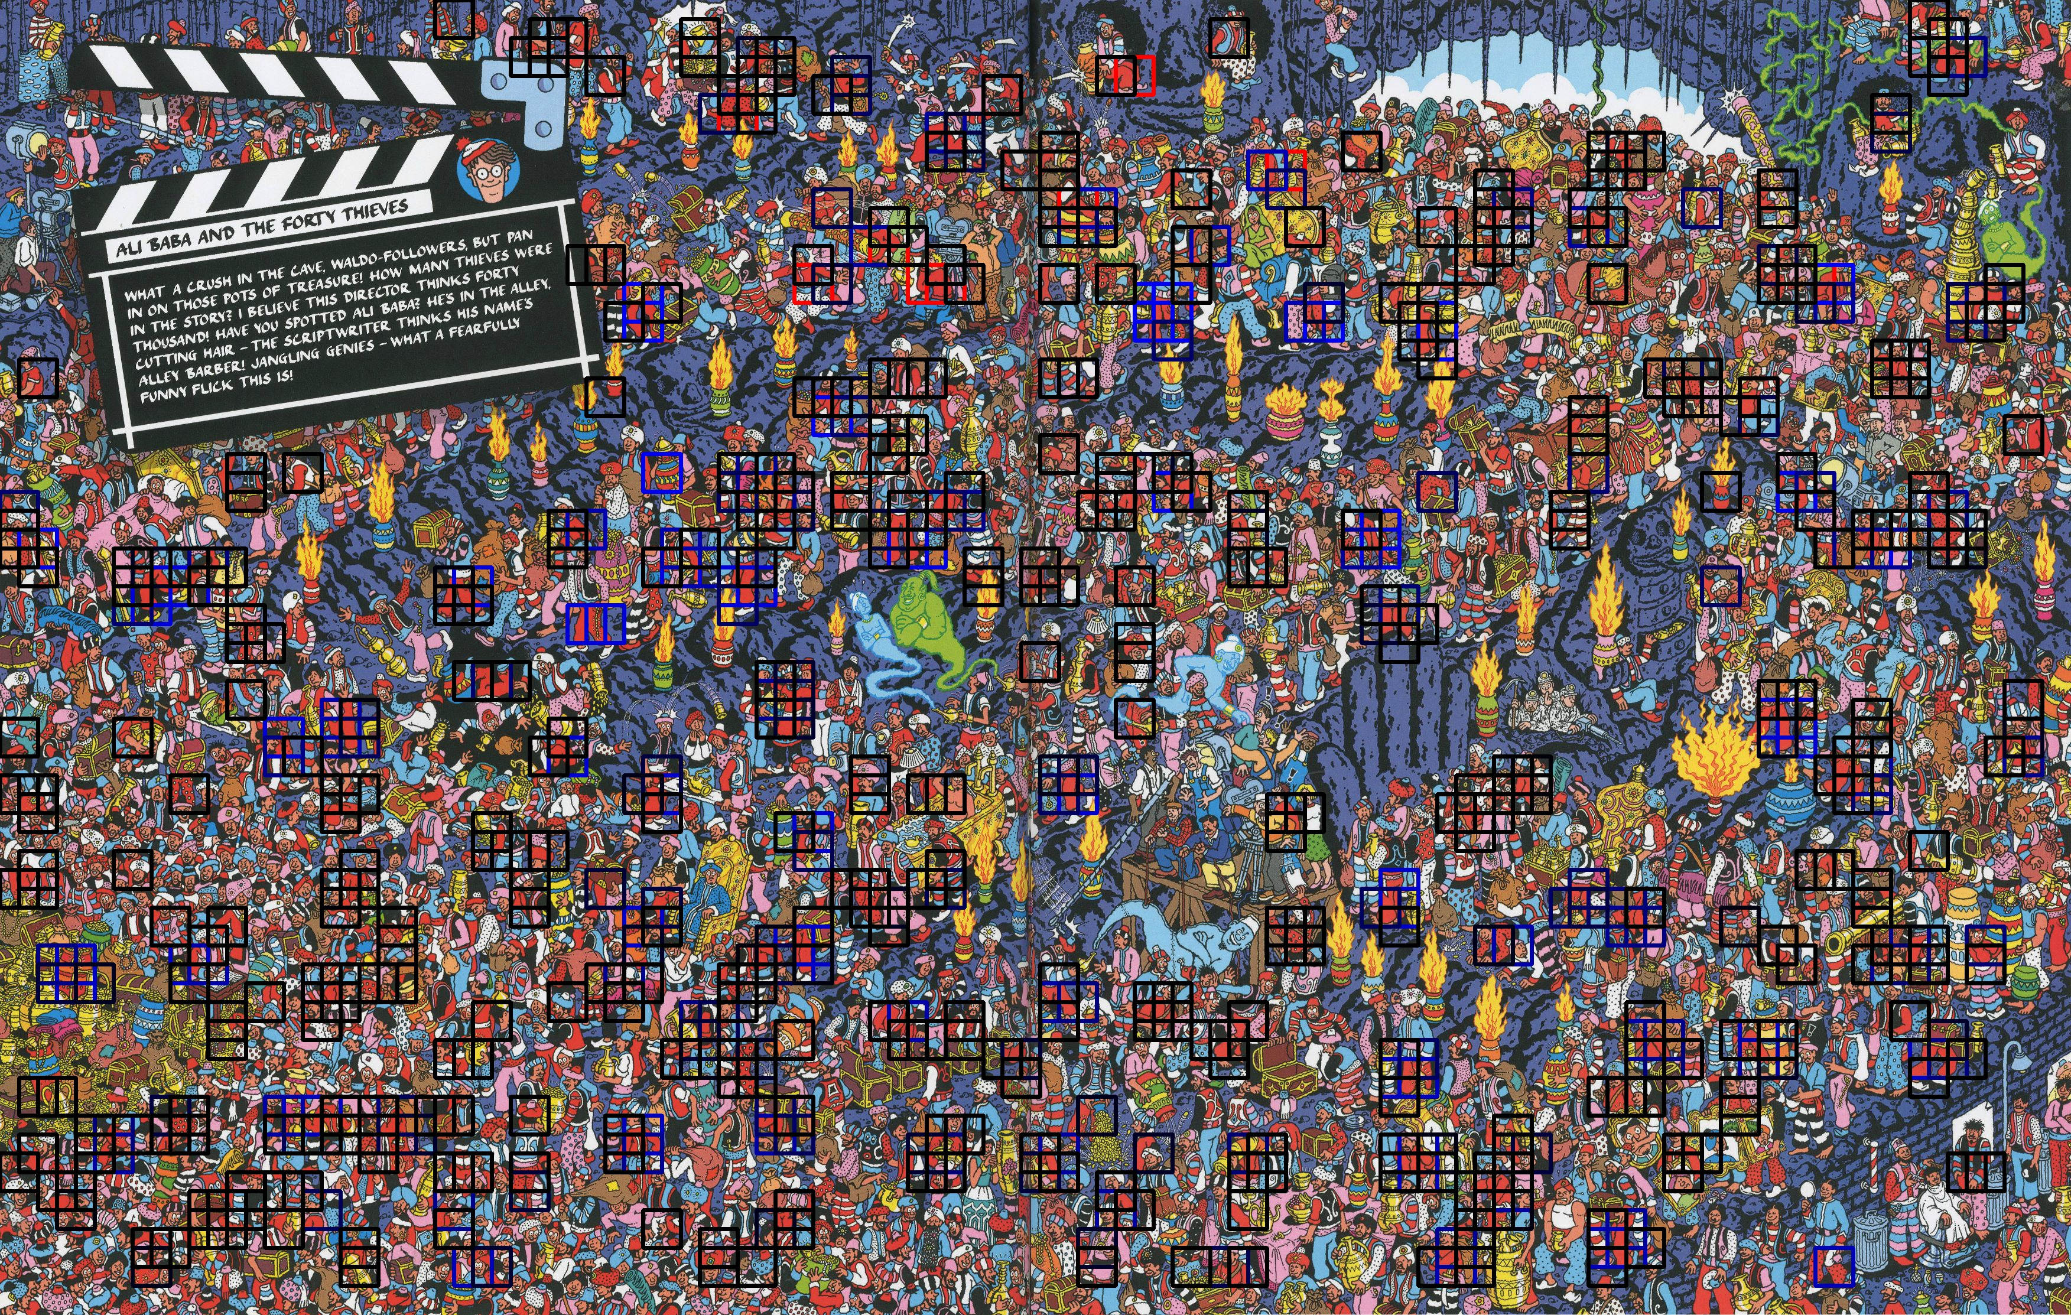
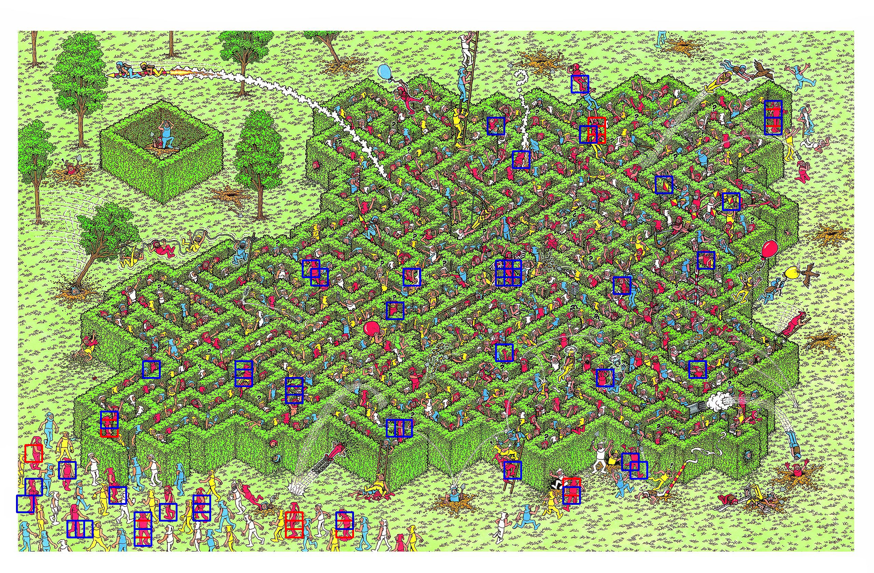
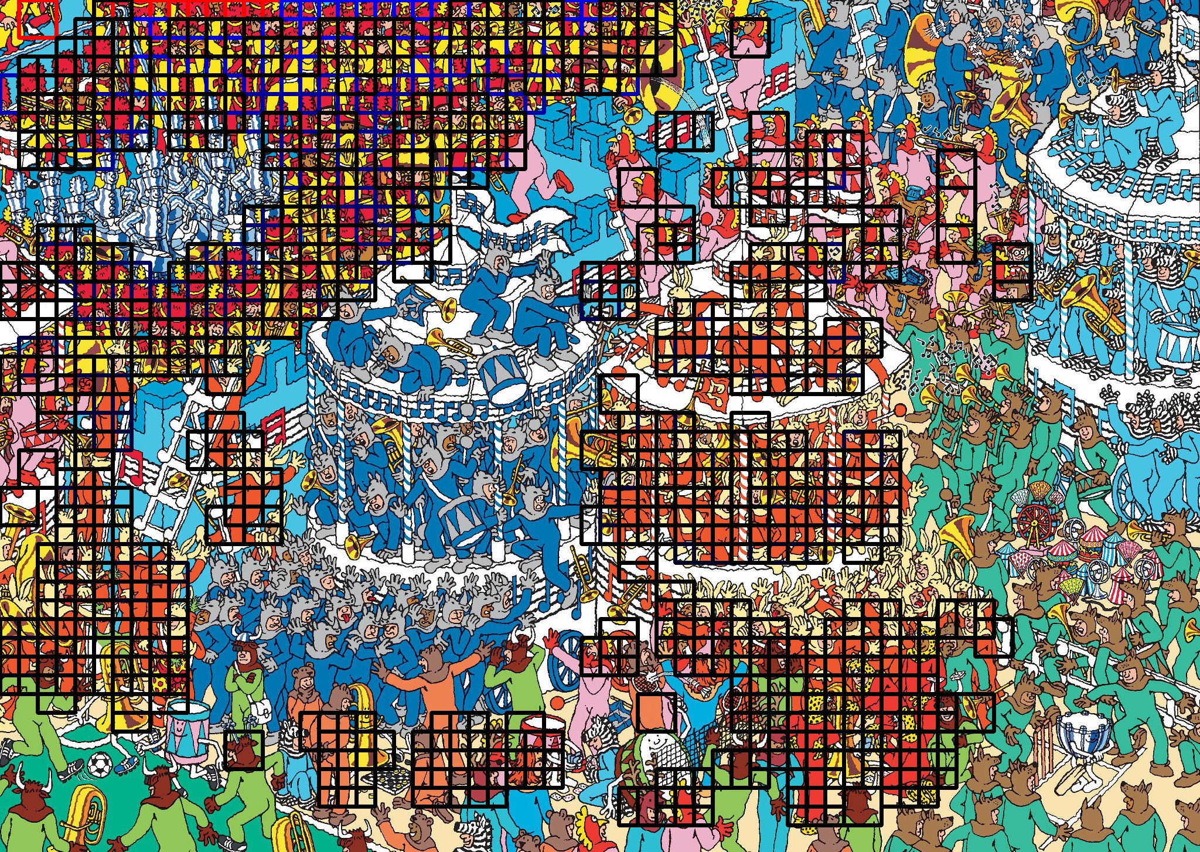
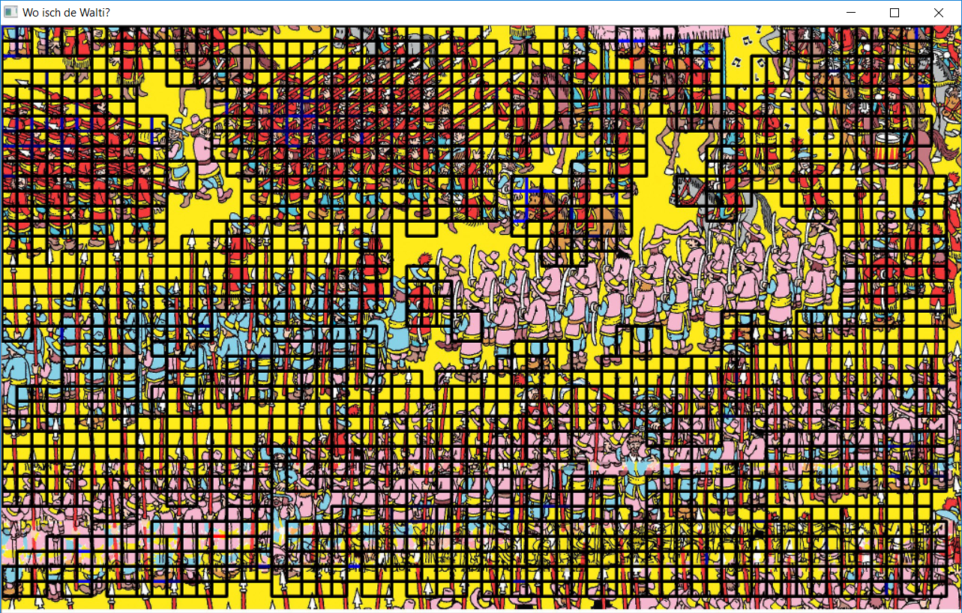
Results

